Slide 1
Bayesian Age Decomposition Modeling of Covid-19 Space-time Dynamics
Andrew B Lawson ^{1,2}
Yao Xin¹
¹Medical University of South Carolina
²Usher Institute, University of Edinburgh, UK

Slide 2
Background
Various examples of Covid-19 modeling during the pandemic: many based on time series only
A few SIR-type models but not spatial
Few examples of space-time modeling, even when Covid-19 is clearly spatial in its spread
Some exceptions:
Awwad FA, et al (2021) PLoS ONE 16(4)
Sartorius, B., et al (2021) Nature Sci Rep 11,
Nazia, N.et al (2022). Nature Sci Rep 12, 9369.
Lawson AB, Kim J.(2022). PLoS One 17(12)

Slide 3
Background
Data generated during the pandemic has changed considerably
In previous work we have examined daily and 3 –day cumulative counts of cases, and deaths. Others looked at 7-day counts.
These were available from the NYT and JHU GitHUB repositories.
Now CDC in the US, has made available weekly counts of cases and deaths at county level for the pandemic from January 2020 to May 2023 (173 weeks)
However, CDC has not made available an age structured county level weekly data set

Slide 4
Focus 1
Covid-19 mortality experience is a major concern.
Age dependence is important as older age groups are particularly vulnerable
During the pandemic variable attempts to shield these groups were made
IN the US, different states had different policies.
However private care homes predominate and their own policies have affected the mortality
Our focus is to assess how far mortality experience in different spatial units (counties) differs from that which would be expected based on the population structure.

Slide 5
Focus 2
To model mortality in counties over time (173 weeks)
To estimate a synthetic > 65 population proportion
Compare the estimate with observed >65 counts provided by SC Dept of health and Environmental Control (DHEC)

Slide 6
Data and Modeling issues
The CDC weekly total death count data is complete
However the SCDHEC data, as supplied was incomplete and anonymized
Different counties had different missingness patterns
This impacts the possible comparisons
It also means that imputation has had to be used : the anonymization was based on any count on the range 1 to 5 inclusive was set to NA. The need for this anonymization is not clear at all as these are county level mortality counts.

Slide 7
ST Modeling of mortality
Counterfactuals generated from assumed models for mortality
A variety of forms could be envisaged.
Models similar to total deaths
Could also assume different age strata have different rates and different models

Slide 8
Basic assumptions

Slide 9
Mortality Models: general lagged dependency model with ST random effect

Slide 10
Notes
Best models found previously at county level for mortality were those dependent on current case count and cumulative counts (thereby tracking the lagged mortality effect) [Lawson and Kim, 2022]
In addition a dependence on previous deaths within the same area is also included. This is termed the lagged model. The model excluding the lagged term is the base model. Each model has an uncorrelated spatial RE.
Additional two other models which varied the random effect are considered: 1) spatial convolution with no lagged term, 2) spatial convolution with lagged term.
All models fitted to CDC data from South Carolina, Ohio, and New Jersey

Slide 11
Table of WAIC values for different models for aggregate data from SC, OH, and NJ
 | SC |  | NJ |  | OH
 | WAIC | pWAIC | WAIC | pWAIC | WAIC | pWAIC
Base model | 22684.5 | 453.65 | 18667.6 | 610.79 | 42057.7 | 582.79
Lagged death dependence | 22590.3* | 600.83 | 17205.0* | 656.88 | 41536.9 | 730.11
Spatial convolution | 22667.9 | 444.97 | 18673.6 | 586.38 | 41530.5 | 724.25
Lagged plus spatial convolution | 22600.6 | 598.87 | 17247.1 | 669.46 | 41519.1* | 724.48

Slide 12
Total Mortality results
Different models fitted mortality data for different states
Here we compare South Carolina (SC),Ohio (OH), and New Jersey (NJ)
Results suggest that :
Base model doesn’t fit well
Lagged dependence model only fits SC and NJ well
For Ohio the spatial convolution and lagged dependence model fits best : this suggests that there is some residual spatial structure in the Ohio data

Slide 13
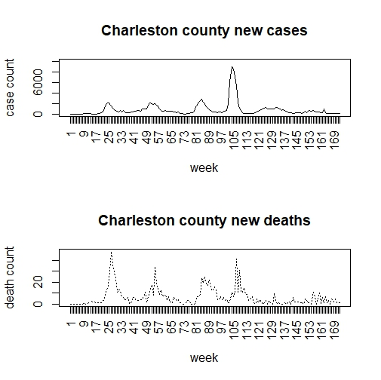
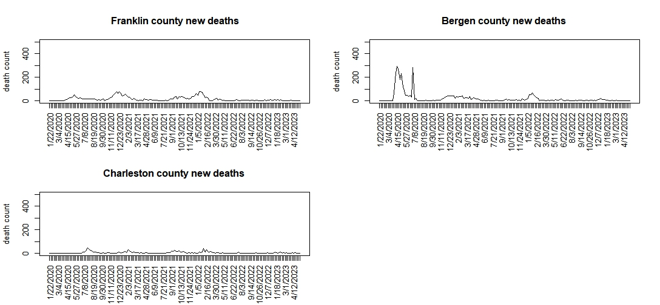
Mortality profiles

Slide 14
Counterfactual prediction from population proportion (G65)

Slide 15
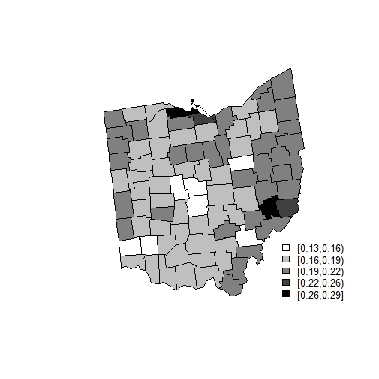
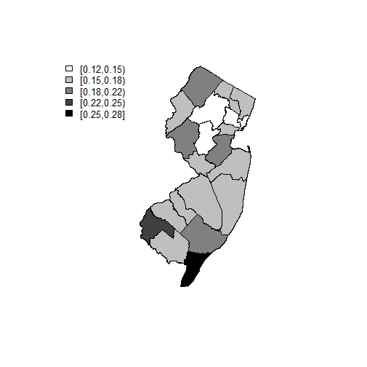
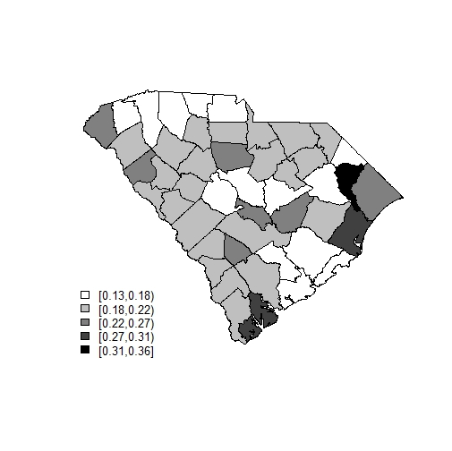
Population proportions (>65) across states

Slide 16
Notes on SC DHEC data issues
Data range 1-5 inclusive anonymized as Na
Required special imputation
Only monthly data supplied
Some counties had incomplete monthly data and, in some cases, extensive missingness
Main urban areas had most completeness.
Here we only used the 15 month periods (March 2020 – May 2021) and 13 counties which were complete for the 15 time periods.

Slide 17
Model fitting
We fitted the main ST death models using McMC via Nimble software
The >65 age strata was simulated as a latent field for the complete set of counties based on the weekly data
Once the model was fitted we extracted the posterior median counts from the samples. We ran single chains for 20K, with burnins of 15K and sample size 5K. Convergence checked using Geweke diagnostics.
To match the SCDHEC monthly data we subsampled the weekly data and latent field and cumulated the counts into 15 month periods

Slide 18
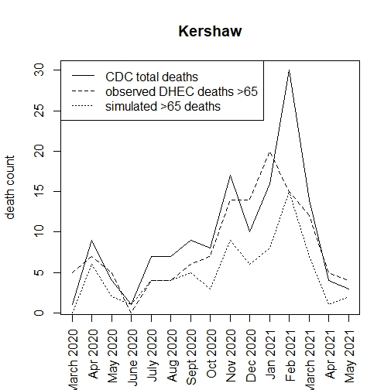
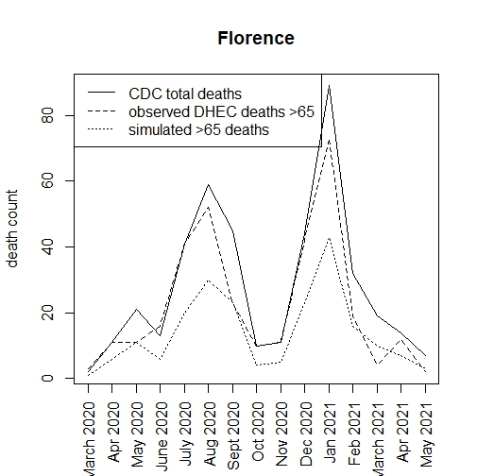
Results: focus on SC only as DHEC age data is available for comparison
Notes:
Note that the DHEC observed counts sometimes exceed the CDC counts; they also exceed mostly the simulated deaths >65

Slide 19
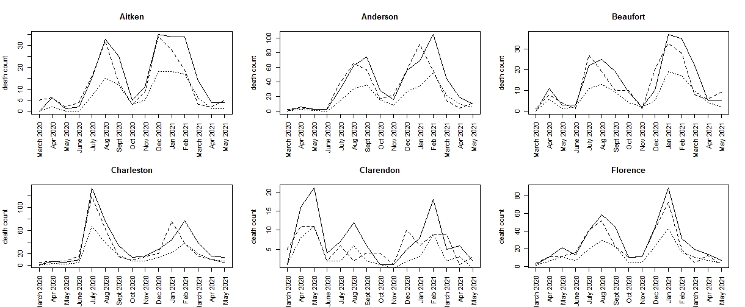
Aitken to Florence profiles

Slide 20
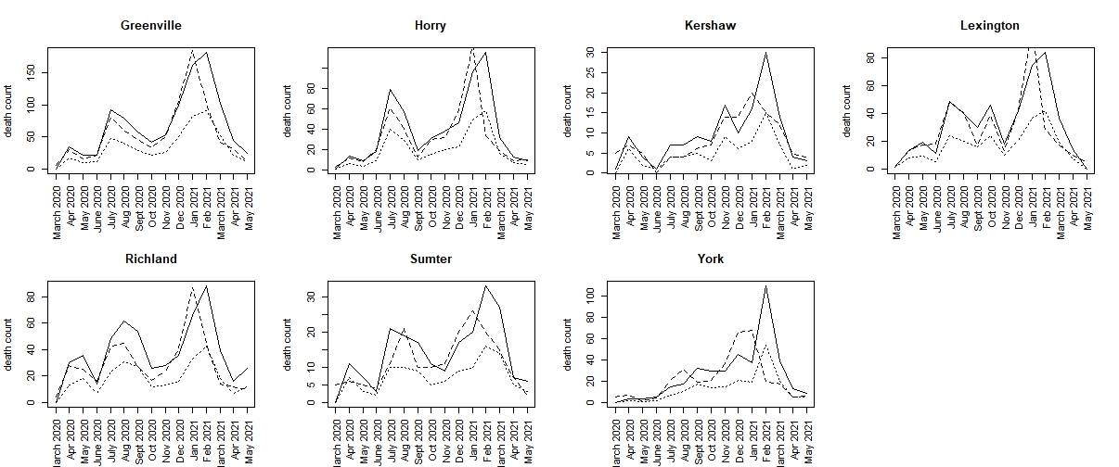
Greenville to York profiles

Slide 21
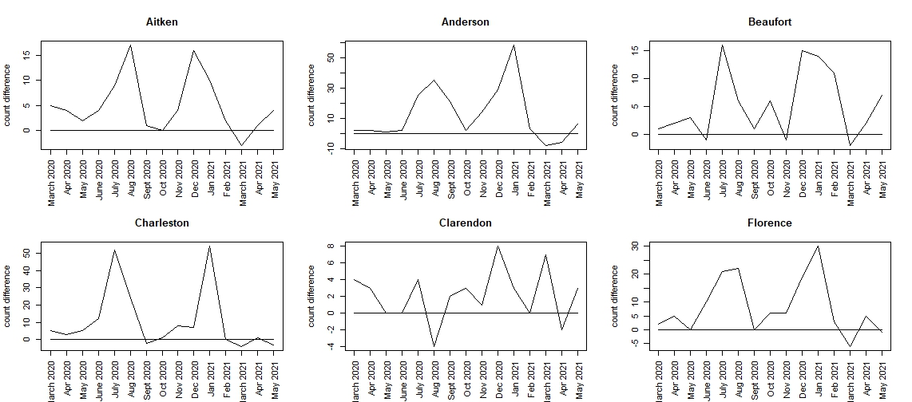
Count difference plots: Aitken to Florence

Slide 22
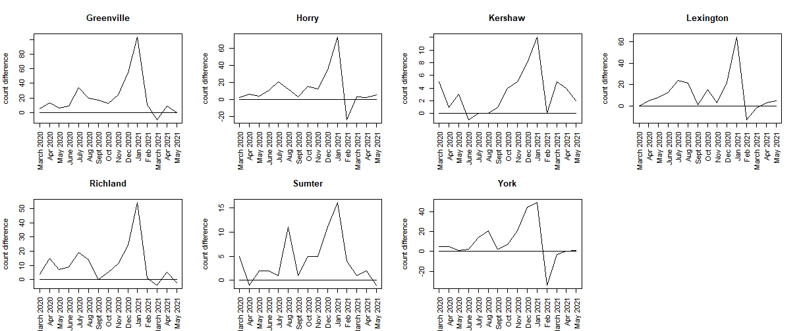
Count difference: Greenville to York

Slide 23
Count differences
County | Mar-20 | Apr-20 | May-20 | Jun-20 | Jul-20 | Aug-20 | Sep-20 | Oct-20 | Nov-20 | Dec-20 | Jan-21 | Feb-21 | Mar-21 | Apr-21 | May-21
Aitken | 5 | 4 | 2 | 4 | 9 | 17 | 1 | 0 | 4 | 16 | 10 | 2 | -3 | 1 | 4
Anderson | 2 | 2 | 1 | 2 | 25 | 35 | 21 | 2 | 14 | 29 | 58 | 3 | -8 | -6 | 6
Beaufort | 1 | 2 | 3 | -1 | 16 | 6 | 1 | 6 | -1 | 15 | 14 | 11 | -2 | 2 | 7
Charleston | 5 | 3 | 5 | 12 | 52 | 24 | -2 | 1 | 8 | 7 | 54 | 0 | -4 | 1 | -3
Clarendon | 4 | 3 | 0 | 0 | 4 | -4 | 2 | 3 | 1 | 8 | 3 | 0 | 7 | -2 | 3
Florence | 2 | 5 | 0 | 10 | 21 | 22 | 0 | 6 | 6 | 19 | 30 | 3 | -6 | 5 | -1
Greenville | 5 | 13 | 6 | 9 | 34 | 20 | 17 | 12 | 24 | 55 | 103 | 11 | -10 | 9 | 0
Horry | 2 | 6 | 4 | 11 | 21 | 12 | 3 | 15 | 12 | 35 | 73 | -24 | 3 | 2 | 5
Kershaw | 5 | 1 | 3 | -1 | 0 | 0 | 1 | 4 | 5 | 8 | 12 | 0 | 5 | 4 | 2
Lexington | 0 | 5 | 8 | 13 | 24 | 21 | 1 | 15 | 3 | 22 | 64 | -13 | -2 | 3 | 5
Richland | 4 | 15 | 7 | 9 | 19 | 14 | 0 | 5 | 11 | 24 | 54 | 1 | -4 | 5 | -2
Sumter | 5 | -1 | 2 | 2 | 1 | 11 | 1 | 5 | 5 | 11 | 16 | 4 | 1 | 2 | -1
York | 5 | 5 | 1 | 2 | 14 | 21 | 2 | 7 | 21 | 45 | 49 | -34 | -3 | 0 | 1

Slide 24
Conclusions and Discussion
During the pandemic there were significant differences between the population proportion of >65 deaths and the actual outcomes.
In general the actual outcomes exceeded the population proportions by considerable amounts
The profiles of count differences suggest that there were major differences in mortality prevention between counties.
Greenville and Anderson are particularly marked with large count excesses at various time points.
The use of expected rates instead of population proportion could be considered. However, this assumes a fixed known underlying rate which of course was not available.

Slide 25
Future work
Established statistical limits on the count differences
Use predictive imputation to include other counties where incomplete outcomes were found.
Extension to multiple age groups would be straightforward.

Slide 26
Thank you !
Paper under review:
Lawson, A. B., and Xin, Y. (2024) Covid-19 Latent Age-Specific Mortality in US states: a county level spatio-temporal analysis with counterfactuals.

